Slide 1


Slide 2

An expanding market with huge opportunity
$32 BILLION PER YEAR MARKET

Slide 3

A breakthrough solution for bloating.
Atrantil is a first in class, patented, clinically proven solution that targets the issue
where it starts-in the small bowel.

Slide 4

Atrantil is comprised of natural, vegan, non-GMO, and gluten free ingredients. Atrantil is also the only NSF Certified for Sport® digestive and bloating
product in the world.

Slide 5

Board Certified Gastroenterologist
Kenneth Brown, MD,
declared his mission to find a safe and natural solution to bloating and abdominal discomfort.
Kenneth Brown, MD
Atrantil has published two clinical trials showing
efficacy in 4 out of 5 patients.

Slide 6

The Real Problem
Methane producing bacteria living in the small bowel.
Archaebacteria feed on free hydrogen to produce methane.

Slide 7

Natural anti-spasmodic that helps
our Quebracho & Horse Chestnut work in the
small bowel.
Peppermint -
A complex polyphenol that soaks up the hydrogen fuel and fractures the cell wall of the Archaebacteria.
Quebracho -
Horse Chestnut -
Enters the fractured cell wall and blocks the methane producing enzyme.

Slide 8

MARKETING MUSCLE
tv
“At age 15 a debilitating digestive condition drastically changed my day-to-day life,
activities, social involvement, energy level and any physical activity. My parents
took me to various doctors, both local and out of state. At age 18, I saw
Dr. Kenneth Brown and was able to try Atrantil. Atrantil has allowed me to
maintain a consistent balanced diet, decreased bloating, doubled my
energy level and has allowed me to work out for the first time in over 3 years.”
KATELYNN | Verified Purchaser
radio + podcasts
patient testimonials
outdoor
social
Abdominal relief supported by marketing muscle, Atrantil is committed to increasing
brand awareness and using integrated marketing techniques. Utilizing traditional media such as radio and billboard to sophisticated internet marketing, podcasts, and store partnerships, KBS works to drive the right people to the shelves where Atrantil is sold.

Slide 9

Dr. Brown knows all too well that healthcare
providers (HCPs) want to be in the know for the
options to help their patients. From day one
Atrantil has taken an aggressive role in educating all HCPs that counsel clients with digestive issues.
We have a team dedicated to personal detailing, clinical trial explanation, client troubleshooting, and best practice applications. Atrantil actively distributes coupons and other incentives for the HCPs to drive customers to the retailers.

Slide 10
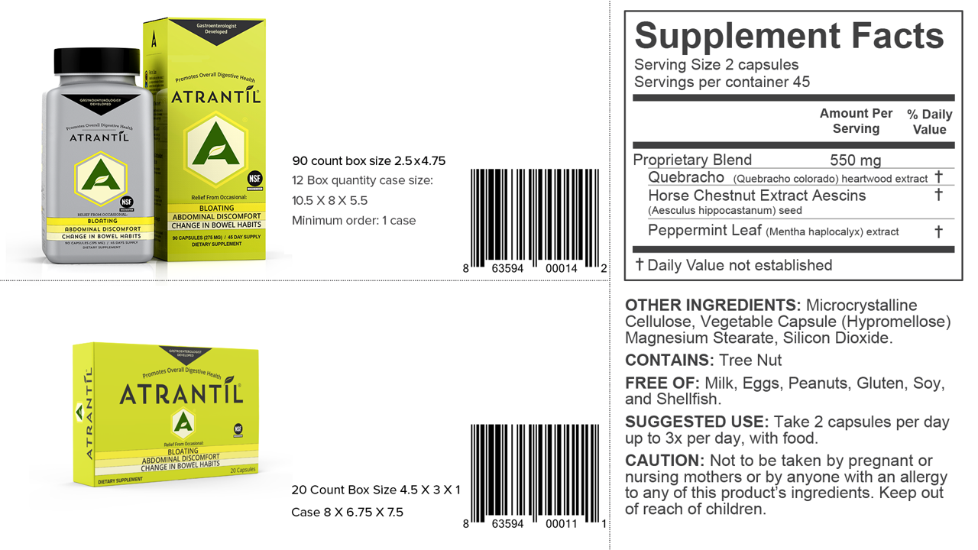
MSRP. $39.95
MSRP. $14.95

Slide 11


